Slide 1
ALFORM: Articulatory Labeling For Optimal Real‑time MRI Experiments
18-844 Final Slides
Joseph Konan

Slide 2
Investment Thesis
(The Elevator Pitch)
FOR MRI technologists and researchers
WHO need reliable articulatory data without wasting scanner time
THE ALFORM system IS A real‑time articulatory tracking tool
THAT shows which articulators are being used and how often, while you scan
UNLIKE expensive trial‑and‑error experiments that only discover missing articulators after the fact
OUR PRODUCT gives instant feedback so you can focus on the right movements and collect better data, faster

Slide 3
PROBLEM
(Before ALFORM)
Offline Labeling & Analysis
Re‑planning
Design & Scan
During the scan:
We guess which tasks will engage target articulators.
We collect RT‑MRI data with no real‑time feedback on articulator usage.
After the scan:
We manually label articulators offline. We discover that key articulators were under‑sampled or missed.
We revise tasks and schedule more scanner time, if budgets allow.
Wasted scanner time
Incomplete biased datasets
Slow, non‑scalable science
Expensive RT‑MRI sessions that don’t capture what we need
Important articulators (e.g., velum, tongue root) under‑represented.
Manual labeling + re‑scans limit sample sizes & slow down progress

Slide 4
Here’s How We Enhance Productivity
By Improving Data Collection Quality
Initiate
Researchers set target articulators & tasks.
Launch ALFORM with the RT‑MRI scan.
Annotate
ALFORM tracks each frame in real time.
Summarizes usage for every articulator.
Calibrate
Identify under‑sampled articulators by speaker.
Add tasks to boost underused categories.
Validate
End with balanced articulatory data.
Fewer re‑scans, better articulatory analysis.

Slide 5
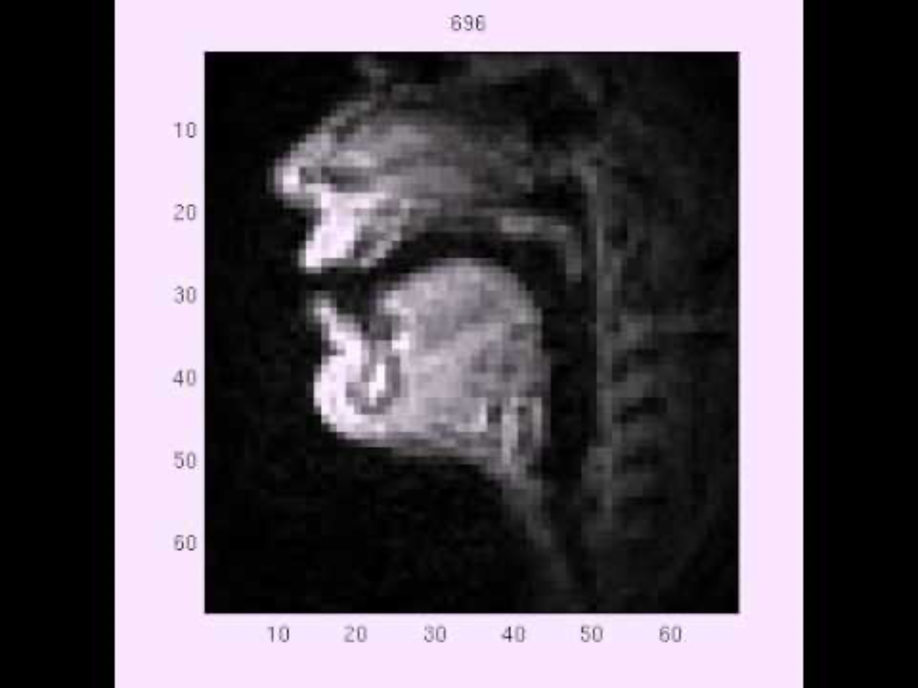
Unique Real-Time Challenge
Articulatory Labels
About 70 to 140 per second
Very Challenging For Human Annotators
Articulators
About 7 per speech sound
Speech Sounds
About 10–20 per second

Slide 6
Unique Real-Time Capabilities
90%
Not Possible With Human Annotators
75%
60%
60%
85%
50%
Xxxxx
Xxxxx xxxxx xxxxxx xxx
xxxx
Xxxxx xxxxx xxxxxx xxx
X xx xxx 1
Xxxxx xxxxx xxxxxx xxx
X xx xxx 1
Xxxxx xxxxx xxxxxx xxx
X xx xxx 3
Xxxxx xxxxx xxxxxx xxx
X xx xxx 4
Xxxxx xxxxx xxxxxx xxx

Slide 7
A Blue Ocean Market
With Critical Need For Real-Time MRI Speech Data
RT‑MRI + Phonetics
Articulatory Imaging Data
Speech Data for Biometrics
Voice Biometrics Market
$1M
Current obtainable niche for RT‑MRI speech with phonetic + articulator labels (ALFORM‑like data), on the order of ~$1–3M per year.
$50M
Niche market for high‑fidelity articulatory speech & imaging datasets (MRI, ultrasound, EMA), roughly ~$10–50M per year worldwide.
$1B
Annual spend on speech/audio data & labeling for ASR, voice AI, and biometrics; sub‑$1B now, plausibly ~$1–2B by 2030.
$5B
Voice biometrics market for authentication & speaker ID, ≈$2–5B today & growing toward ~$10B by 2030.

Slide 8
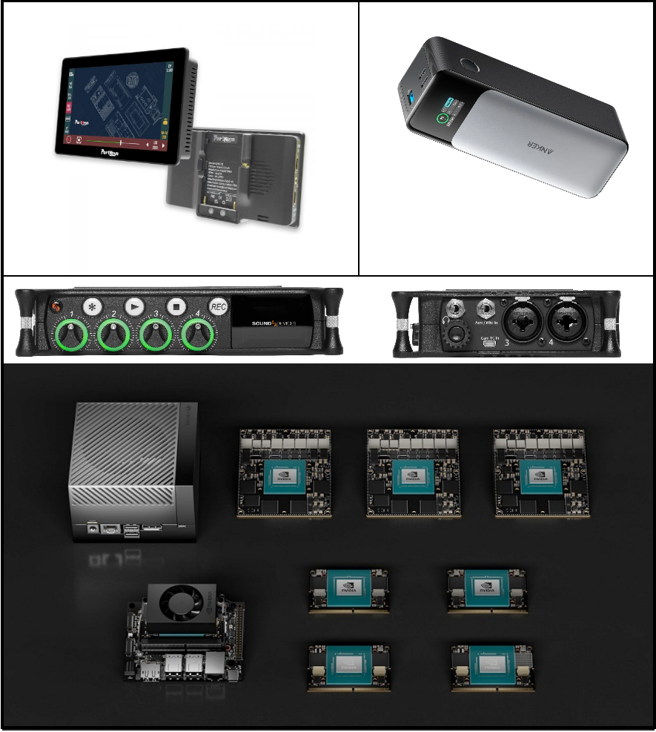
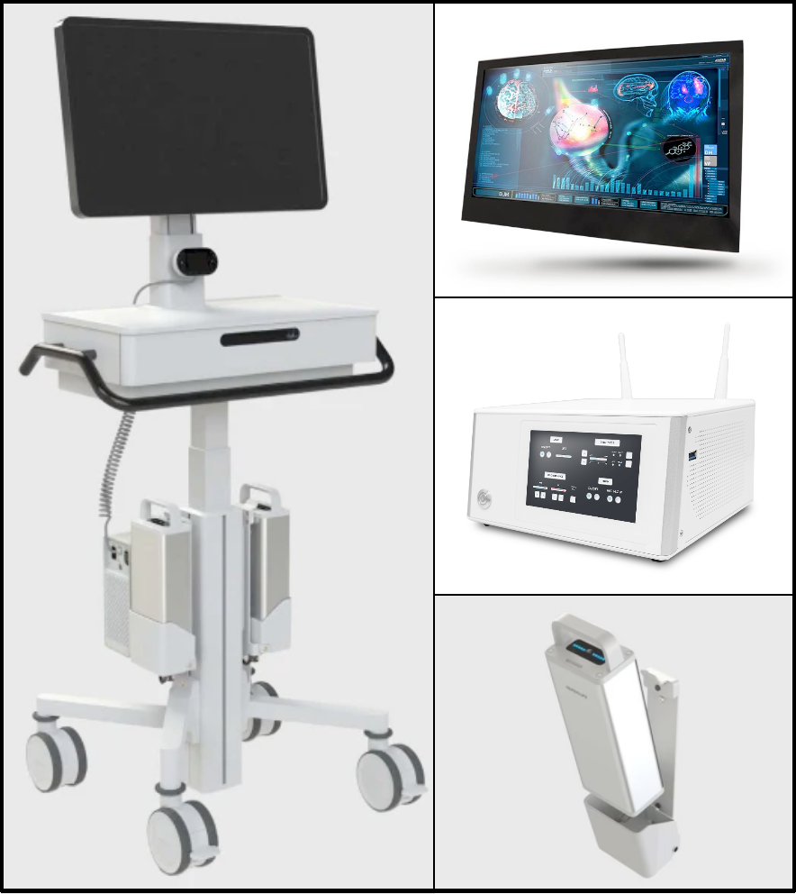
How Customers Use Our Product
In Medical Applications
A Jetson AGX Orin is used for development, with the compute + monitor + interface under 100W.
Stricter medical certification is required later on. A medical cart like this would be the next phase.

Slide 9
How Our Product Works
With Deep Learning Technology
Enhanced Phonetic Annotated Datasets With Articulations
Optimized Recurrent And Convolutional Neural Architectures
Inference Hardware Optimization Of Performance-Per-Watt
Have phoneticians expertly annotate speech recordings
Map phonetic labels to physiological articulations
Final annotations are speech data & articulatory label pairs
Recurrence enables efficient temporal processing
Convolutions enable hierarchical representation
Minimize cross entropy loss of predicted alignments
Models are quantized from 32bit to 8bit
Different inference hardware are experimented with
Different wattages are experimented with

Slide 10
What Makes Our Product Different
Efficiency, Efficacy, and Economics
Is it fast?
Over 100X faster than human labelers
Efficiency
Is it accurate?
90% F1 across articulators
Is time saved?
Less need to re-do runs
Efficacy
Economics

Slide 11
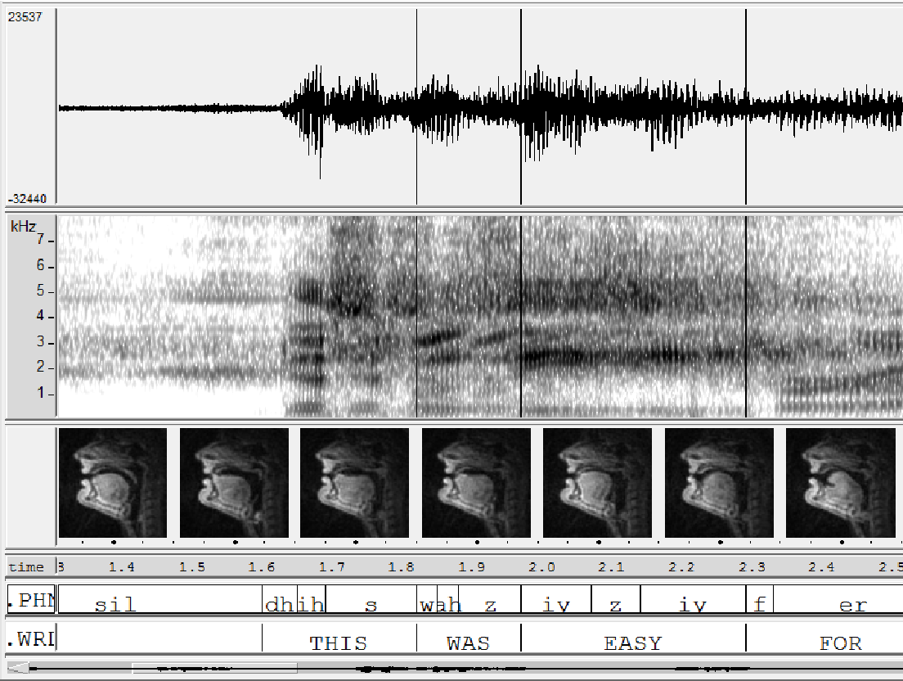
Our Primary Modality Is Speech
Each frame has 1 phoneme label and 7 articulatory labels

Slide 12
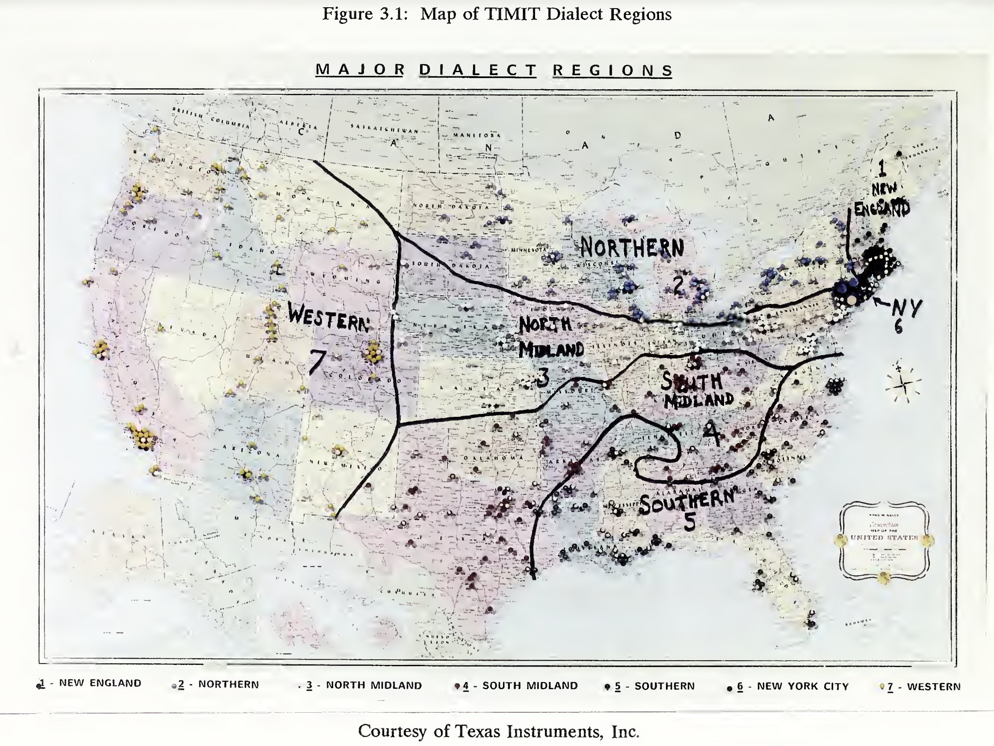
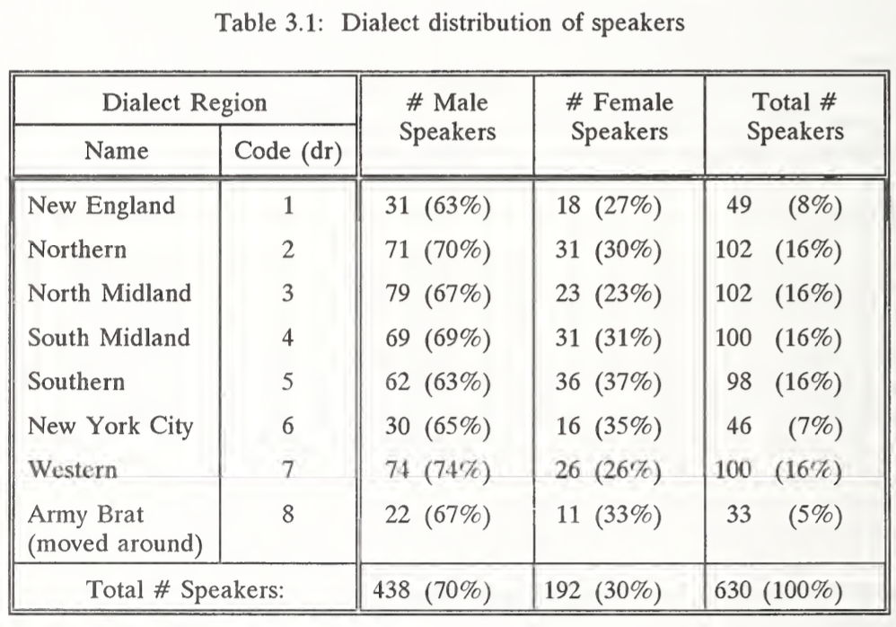
Here Are Our Demographics
Focused On 8 Dialect Regions For American English

Slide 13
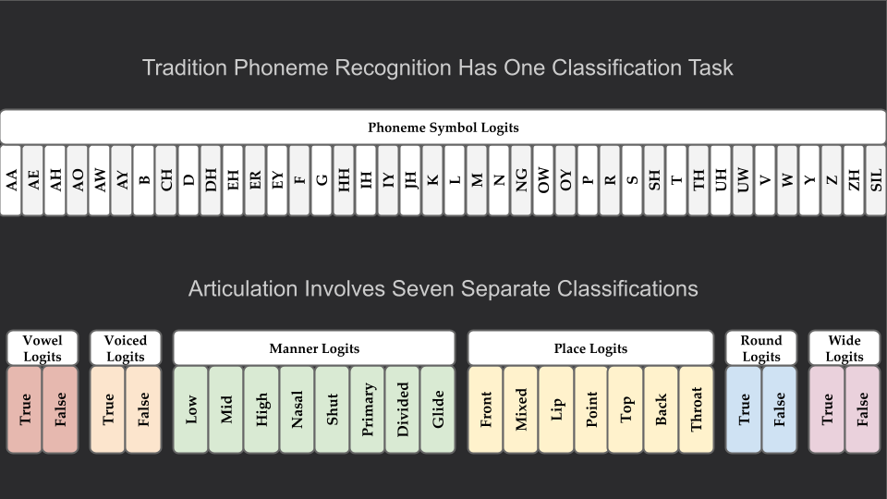

Slide 14
Here Are Our Metrics
On Articulator Recognition By Gender & Dialect
 | Vowel | Voiced | Manner | Place | Modified | Round | Wide
FEMALE | 93% | 97% | 87% | 85% | 96% | 93% | 87%
MALE | 92% | 97% | 86% | 85% | 96% | 94% | 89%
DR1 | 92% | 97% | 85% | 85% | 95% | 92% | 87%
DR2 | 93% | 97% | 87% | 86% | 97% | 95% | 89%
DR3 | 92% | 97% | 87% | 85% | 97% | 95% | 89%
DR4 | 92% | 96% | 86% | 84% | 96% | 94% | 88%
DR5 | 92% | 97% | 85% | 84% | 96% | 93% | 87%
DR6 | 92% | 97% | 87% | 85% | 96% | 94% | 87%
DR7 | 92% | 97% | 86% | 85% | 97% | 93% | 89%
DR8 | 92% | 96% | 86% | 85% | 97% | 94% | 88%
ALL | 92% | 97% | 86% | 85% | 96% | 94% | 88%

Slide 15
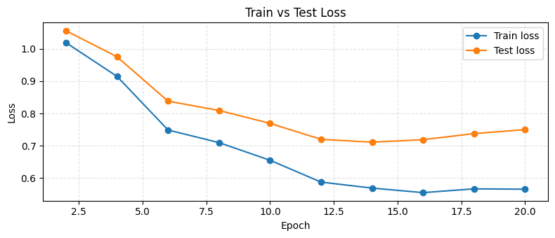
Here Are Our Metrics
On Model Training Optimization
Model overfits, but shows capability of learning more-complex representations.
Future work will look into closing the gap using different loss functions as regularizers.

Slide 16
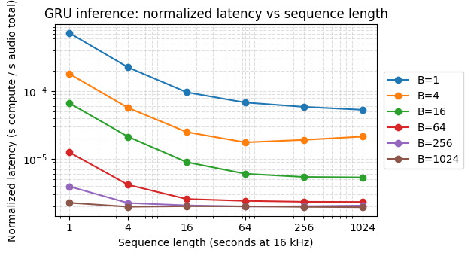
Here Are Our Metrics

Slide 17
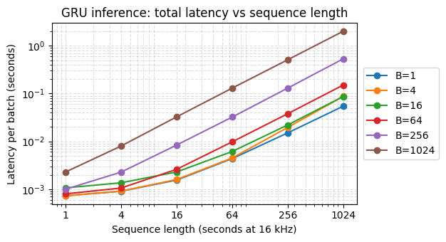
Here Are Our Metrics

Slide 18
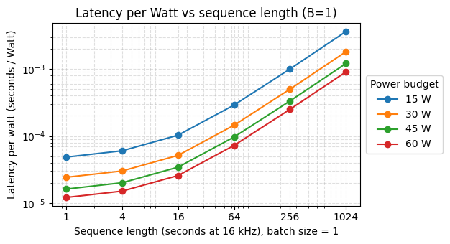
Here Are Our Metrics

Slide 19
The Next Phase Needs $10K
To Prototype On Medical-Grade Hardware (IEC 60601-certified)
01
Computer
Rugged AI computer with shielded medical I/O and ESD‑safe chassis so plugging in cameras and sensors is safe for staff and patients.
Monitor
High‑brightness, disinfectant‑safe screen that stays readable under hospital lighting and survives constant cleaning without damage.
02
03
Chassis
Stable, low‑tip medical cart with smooth hospital grade casters and cable routing so the whole system moves safely between patients.
04
Battery
Fault‑tolerant medical battery pack with thermal and overload protection, built to power the cart for hours without risky DIY wiring.
$5,800
$1,200
$1,500
$1,500

Slide 20
Considerations TODO
Many practical challenges need to be considered.
RNNs on Edge Impulse?
RNNs aren’t supported, so it needs to be hacked or CNN is needed instead.
Propose HW Configs
Give some options for low, medium, and high end recommended configs.
Testing On Jetson AGX Orin
Hardware optimization needs to be re-run on the different AGX constraints.
Real-Time Demonstration
Optimal hardware usage is likely not real-time, but RT would improve demo.
Applied Example
An example articulatory report needs to be made for the medical technician.
Training Improvement
Close the overfitting gap and consider a contrastive loss for robustness.

Slide 21
Investment Thesis Recap
(The Elevator Pitch)
FOR MRI technologists and researchers
WHO need reliable articulatory data without wasting scanner time
THE ALFORM system IS A real‑time articulatory tracking tool
THAT shows which articulators are being used and how often, while you scan
UNLIKE expensive trial‑and‑error experiments that only discover missing articulators after the fact
OUR PRODUCT gives instant feedback so you can focus on the right movements and collect better data, faster

Slide 22
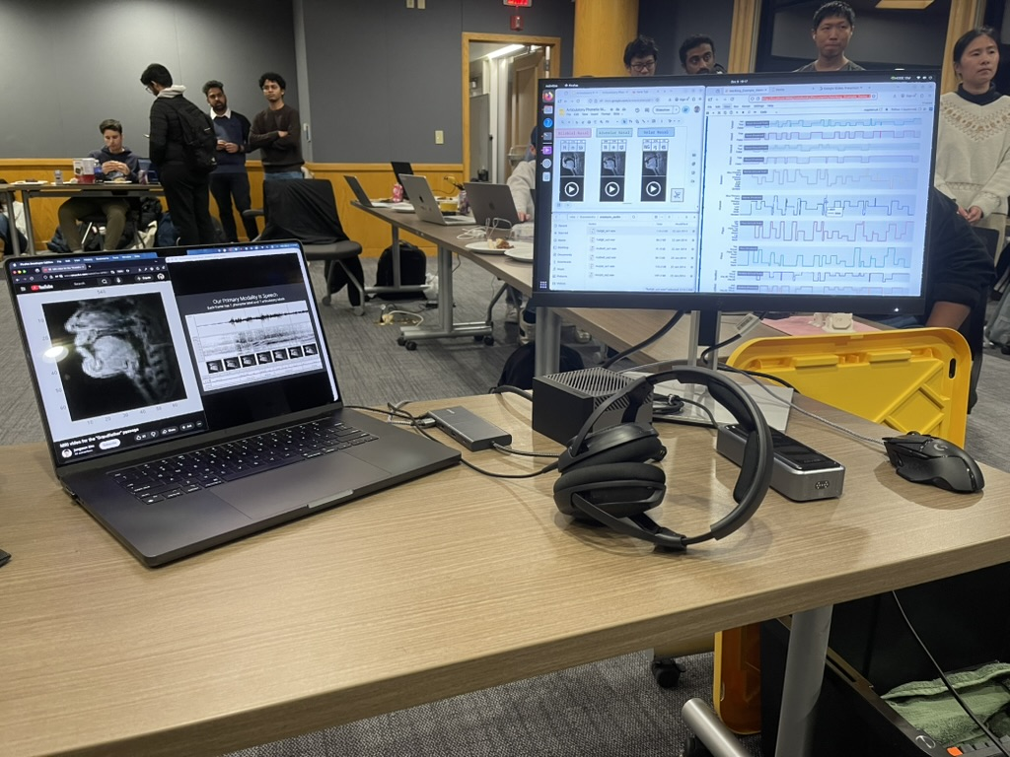
Thank You!

Slide 23
Acknowledgements
MRI images are from USC 75-Speaker Speech MRI Database
Gender and Dialect region data are from TIMIT
Source link to the articulation video is embedded
Financial estimates are approximate
A language model was used to facilitate drafting

